Slide 1
Tree-Structured Attention with Hierarchical Accumulation
ICLR 2020

Slide 2
Introduction
Leveraging the hierarchical structures of language improves the performance.
Ad hoc tree-structured models often operate on recursive mechanisms that is not parallelizable, hindering their application in larger-scale training.

Slide 3
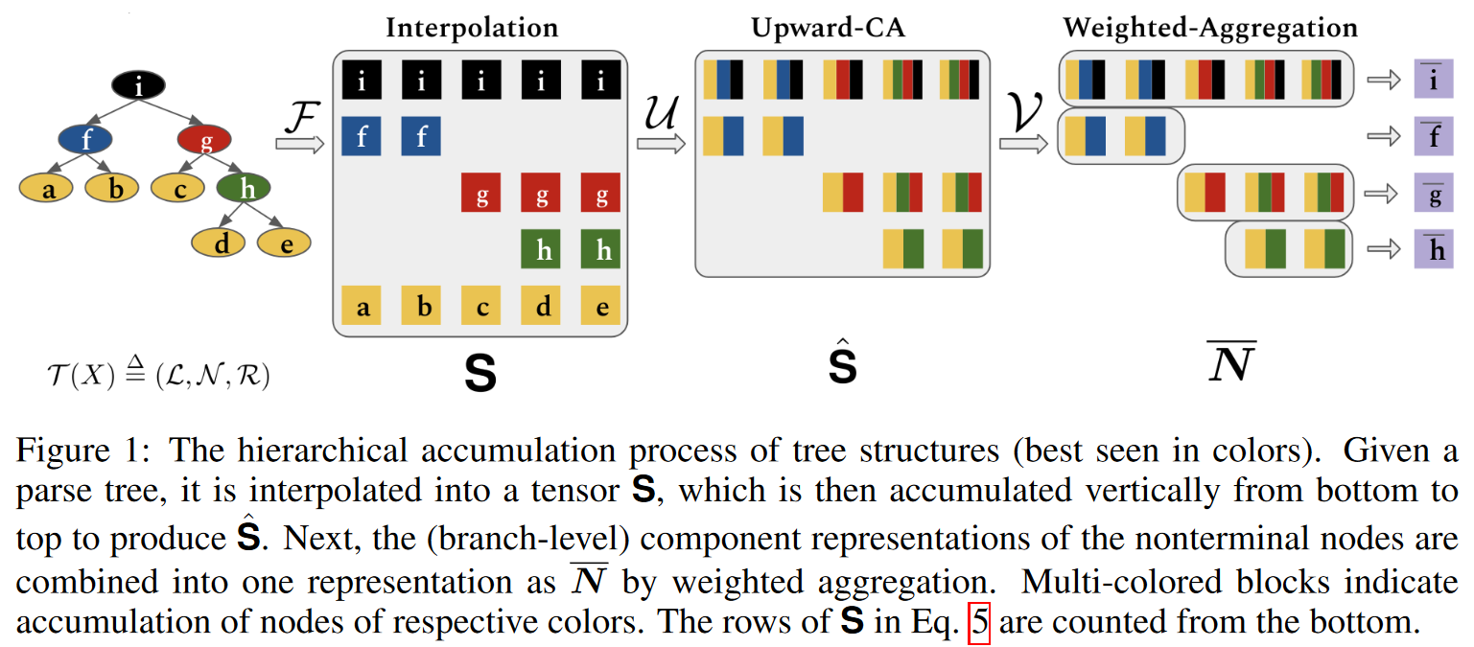
Encoding Trees with Hierarchical Accumulations

Slide 4
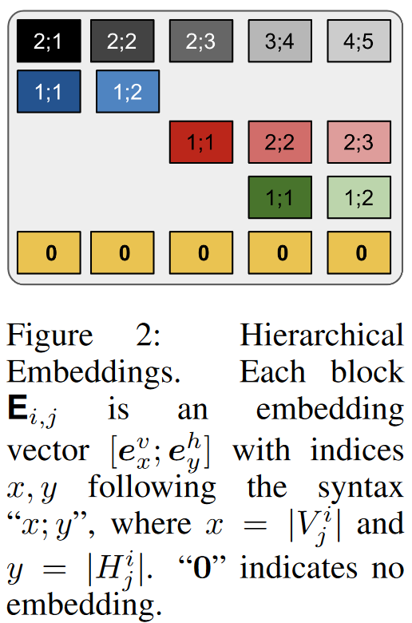
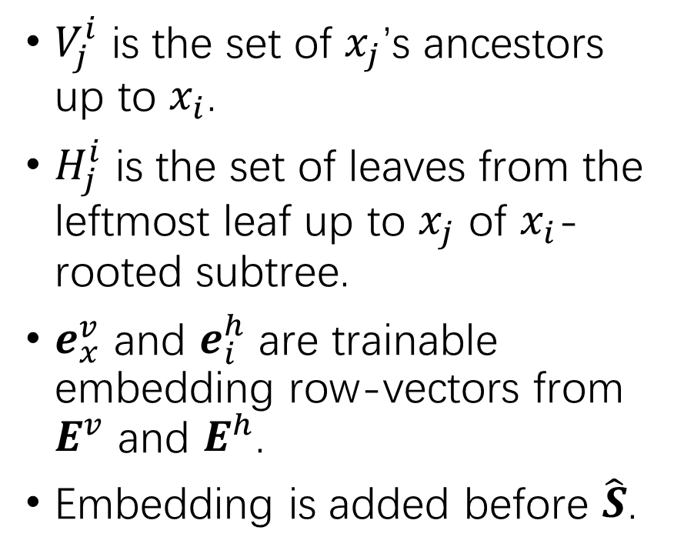
Hierarchical Embeddings
$V_{j}^{i}$ is the set of $x_{j}$’s ancestors up to $x_{i}$.
$H_{j}^{i}$ is the set of leaves from the leftmost leaf up to $x_{j}$ of $x_{i}$-rooted subtree.
$e_{x}^{v}$ and $e_{i}^{h}$ are trainable embedding row-vectors from $E^{v}$ and $E^{h}$.
Embedding is added before $\hat{S}$.

Slide 5
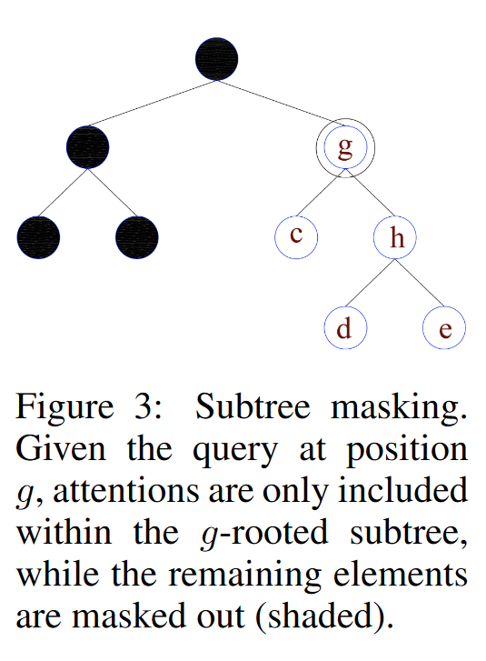
Subtree Masking
Each node-query has access only to its own subtree descendants, but not to its ancestors and siblings.
Each leaf-query has access only to all other leaf-keys, like in the Transformer.
Subtree Masking is done in encoder self-attention.

Slide 6
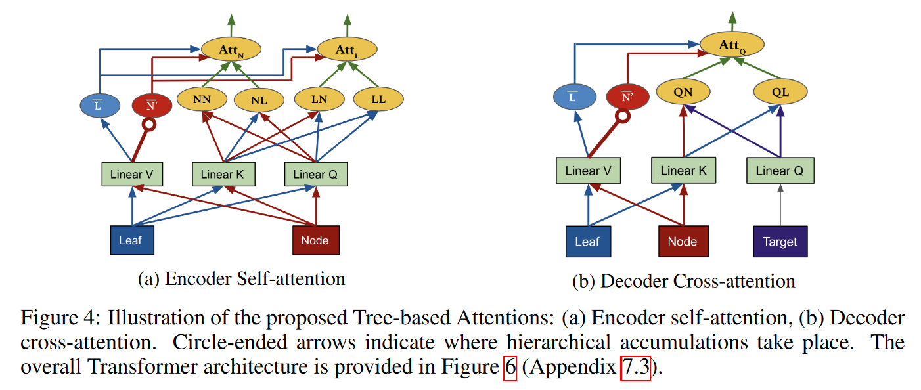
Integrating into Transformer Framework

Slide 7
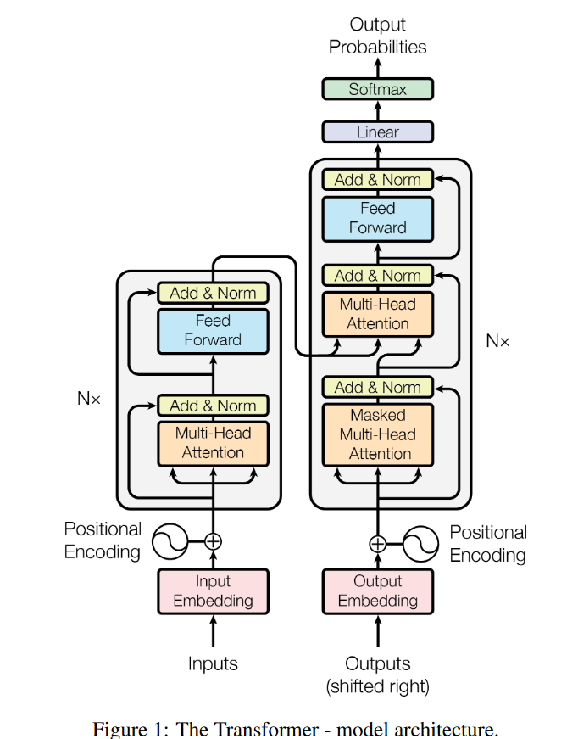
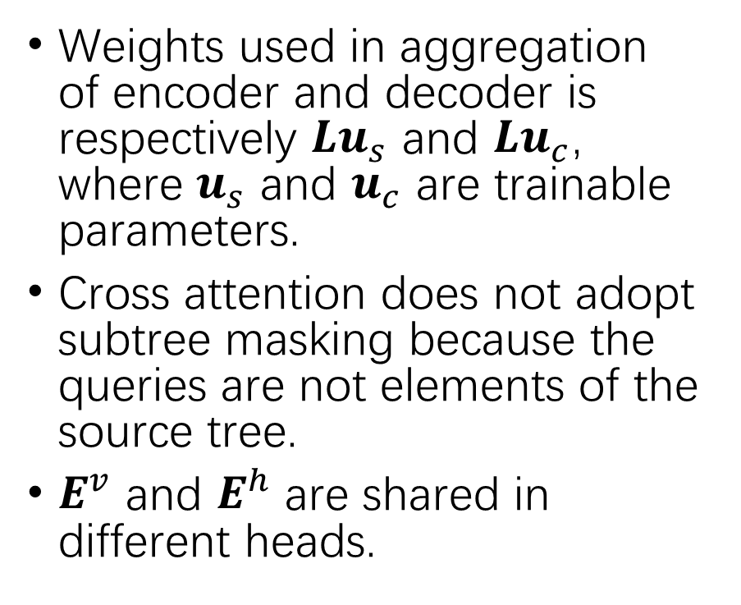
Integrating into Transformer Framework
Weights used in aggregation of encoder and decoder is respectively $Lu_{s}$ and $Lu_{c}$, where $u_{s}$ and $u_{c}$ are trainable parameters.
Cross attention does not adopt subtree masking because the queries are not elements of the source tree.
$E^{v}$ and $E^{h}$ are shared in different heads.

Slide 8
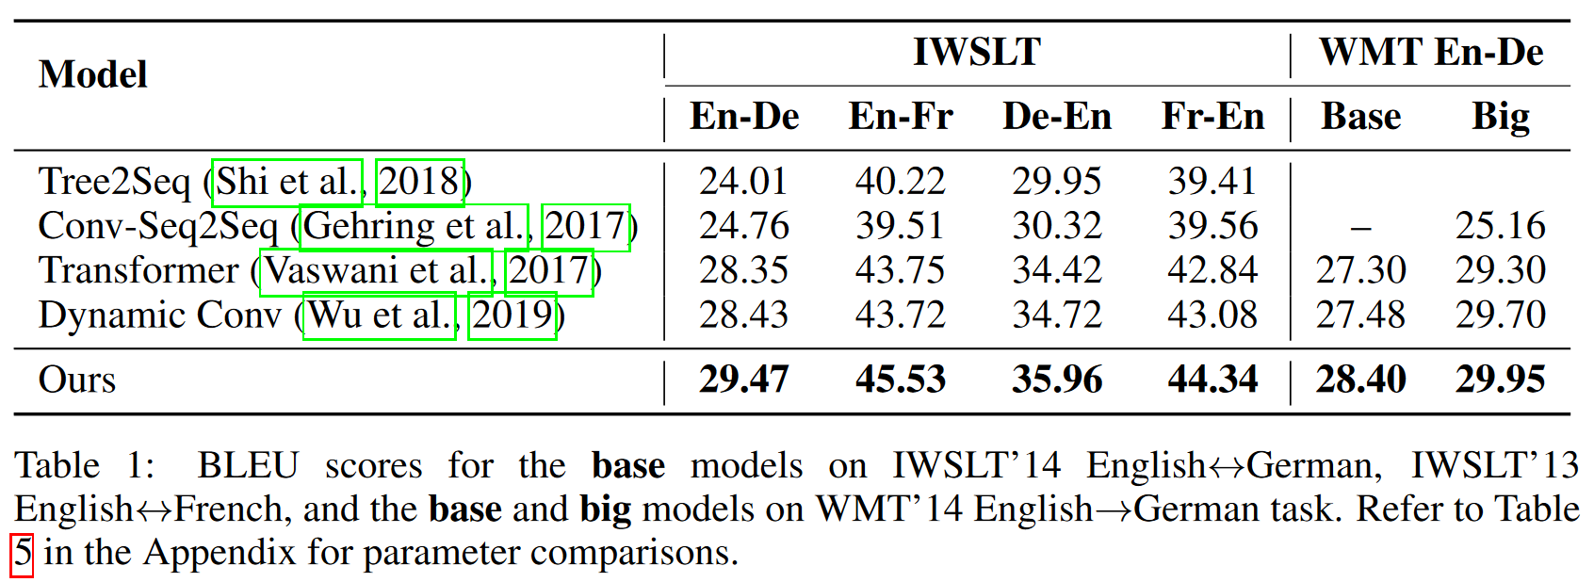
Experiments
Neural Machine Translation

Slide 9
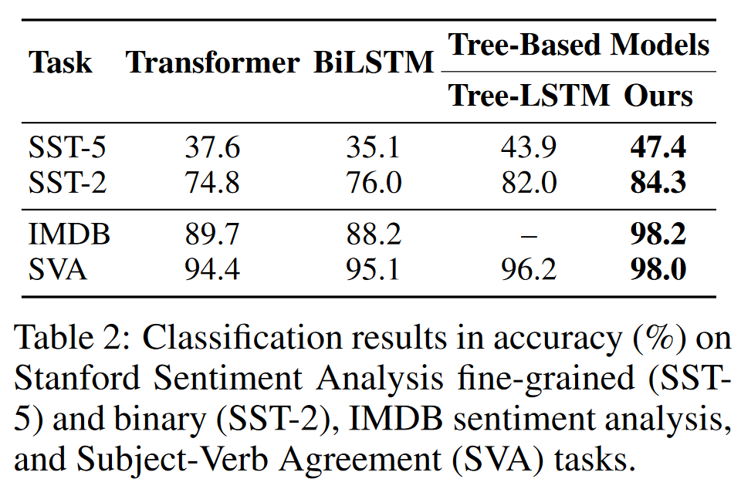
Experiments
Text Classification

Slide 10
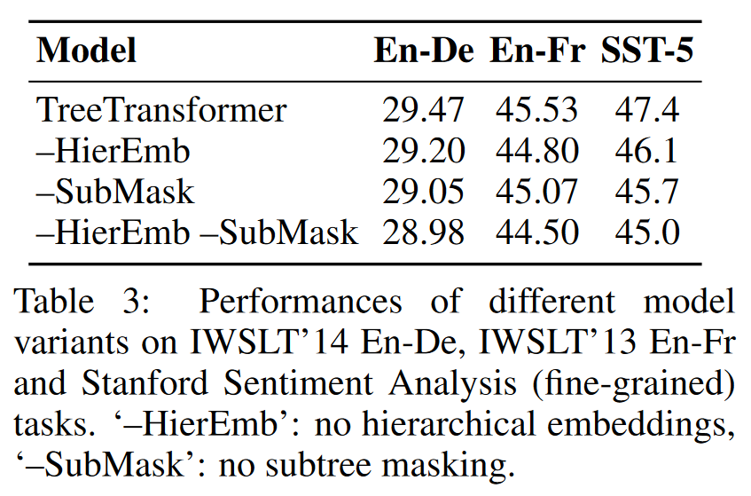
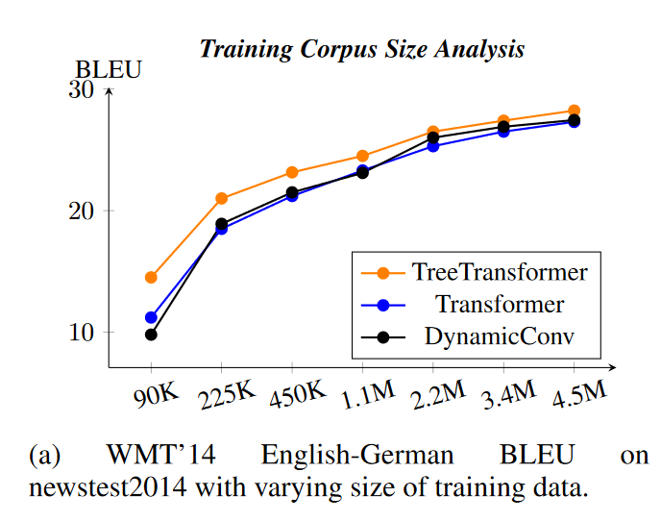
Experiments
Ablation Study
Effectiveness on Small Datasets

Slide 11
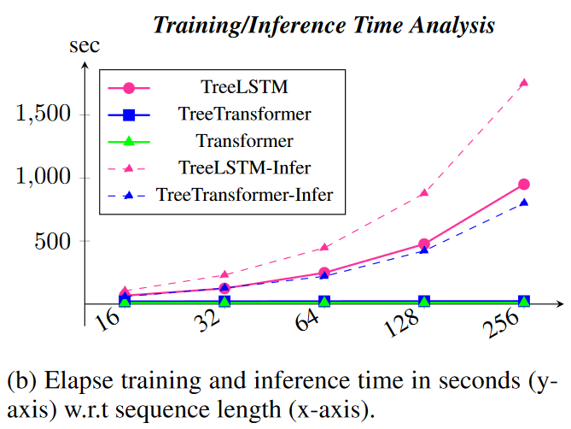
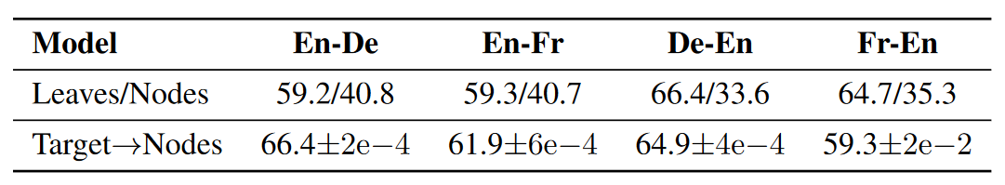
Experiments
Training Time Analysis
Phrase- vs. Token-level Attentions.

Slide 12
Conclusion
A novel approach to incorporate constituency parse trees to the attention mechanism of the Transformer network.
Fully parallelizable.
Outperformed SOTAs on various NLP tasks involving machine translation and text classification.

